Slide 1
Botany Final Review
Log on to insight360.einstruction.com
Enter your student id and session code.

Slide 2
Pteridophytes
Vascular Seedless Plants
Phylum
Pterophyta: Ferns
Lycophyta: Club mosses.
Sphenophyta: Horsetails
Psilotophyta: Whisk ferns
General characteristics: Vascular system allows them to stand upright. No seeds. 2 part life cycle: Sporophyte and Gametophyte

Slide 3
Taxonomy
4 Major Divisions of the Plant Kingdom
Bryophytes
Pteridophytes
Gymnosperms
Angiosperms

Slide 4
Bryophytes
Non-vascular seedless plants
Division
Bryophyta: Mosses
Hepatophyta: Liverworts
Anthocerophyta: Hornworts
General charateristics: No vascular system so they are low lying. No seeds. 2 Part life cycle: Sprophyte and Gametophyte

Slide 5
Gymnosperms
Phylum
Coniferophyta: Conifers
Cycadophyta: Cycads
Gingkophyta: Gingko
Gnetophyta: Gnetophytes
General characteristics: Vascularized plants with naked seeds. Non-flowering

Slide 6
Phylum: Anthophyta
Angiosperms: All flowering plants
Class
Monocotyledon: One seed leaf (cotyledon). Parallel veins in leaf, spreading roots, and floral parts in 3’s. Grasses, palms, orchids, lilies, Ti plants, ginger, Bamboo,banana

Slide 7
Phylum: Anthophyta
Angiosperms: All flowering plants
Class
Dicotyledon: Two cotyledons, net veins in leaf, branching tap roots. Floral parts in 4’s and 5’s. Koa, Ohia, hibiscus, roses, beans, daisies, mint, myrtle, and many many more.

Slide 8
Questions
What Division do Ponderosa Pines belong to?
A.Bryophyta B.Coniferophyta C.Angiosperm D.Gymnosperm
What are the charateristics of Pteridophytes?
Which of the following are Monocots?
Pinion B. Roses C. Lilly D. Tomato
4. What are the characteristics of a Dicot?

Slide 9
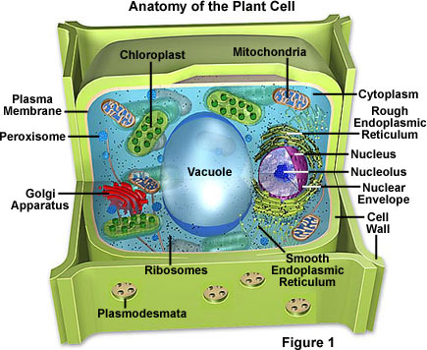
Plant Cell

Slide 10
Questions
5. Where does photosynthesis take place in the plant cell?
Which of the following are not in an animal cell?
A. Ribosomes B. Nucleus C. Mitochondria D. Vacuole

Slide 11
Plant Families
Rosaceae: Rose Family
Regular flowers- 5 sepals and 5 petals; multiple stamens- minimum of five, often multiples of five
Common medicinal constituent: tannins

Slide 12
Lamiaceae: Mint Family
Square stalks, simple opposite leaves
Common Constiuent: Aromatic/Volatile Oils (anti-microbial, promote sweating)
5 sepals (fused so only the tips are separate), 5 fused petals (asymmetrical and irregular sizes, but usually 2 petals up, 3 petals down. Tubular corolla), 4 stamen (one pair longer than the other)

Slide 13
Questions
What family would have a flower with 5 petals and multiple stamens?
Rose B. Mint C. Aster D. Lilly
What are the characteristics of the Mint Family?
Which family has composite flowers?
A.Rose B. Mint C. Aster D. Lilly
What is the Scientific name for the Night Shades?
11. Give an example of a night shade.

Slide 14
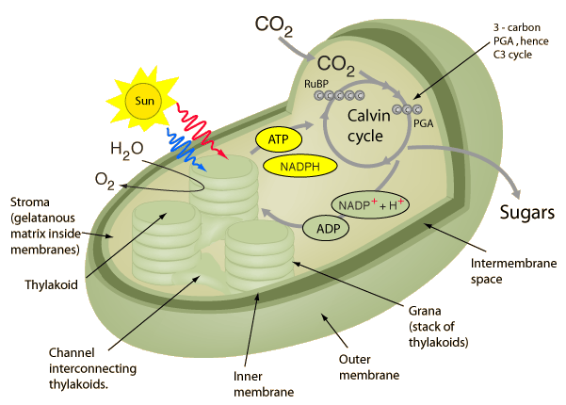
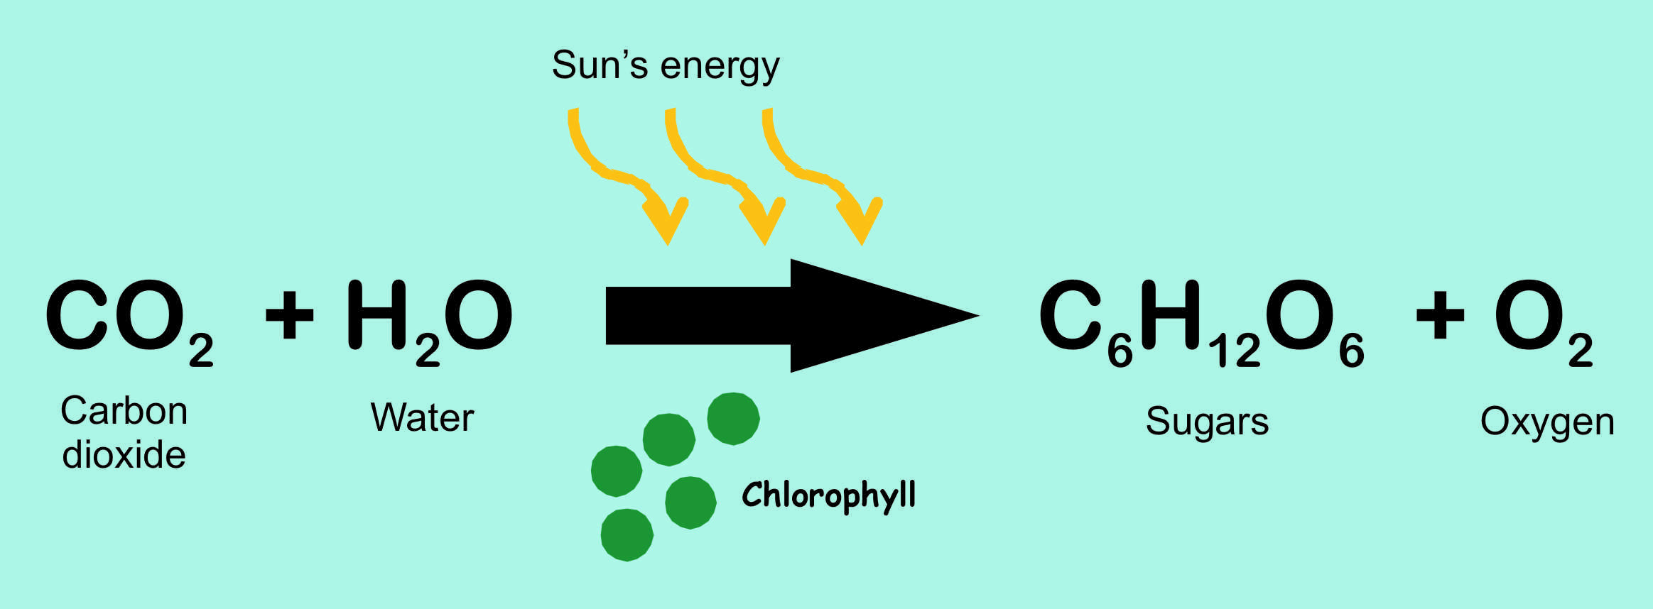
Photosynthesis

Slide 15
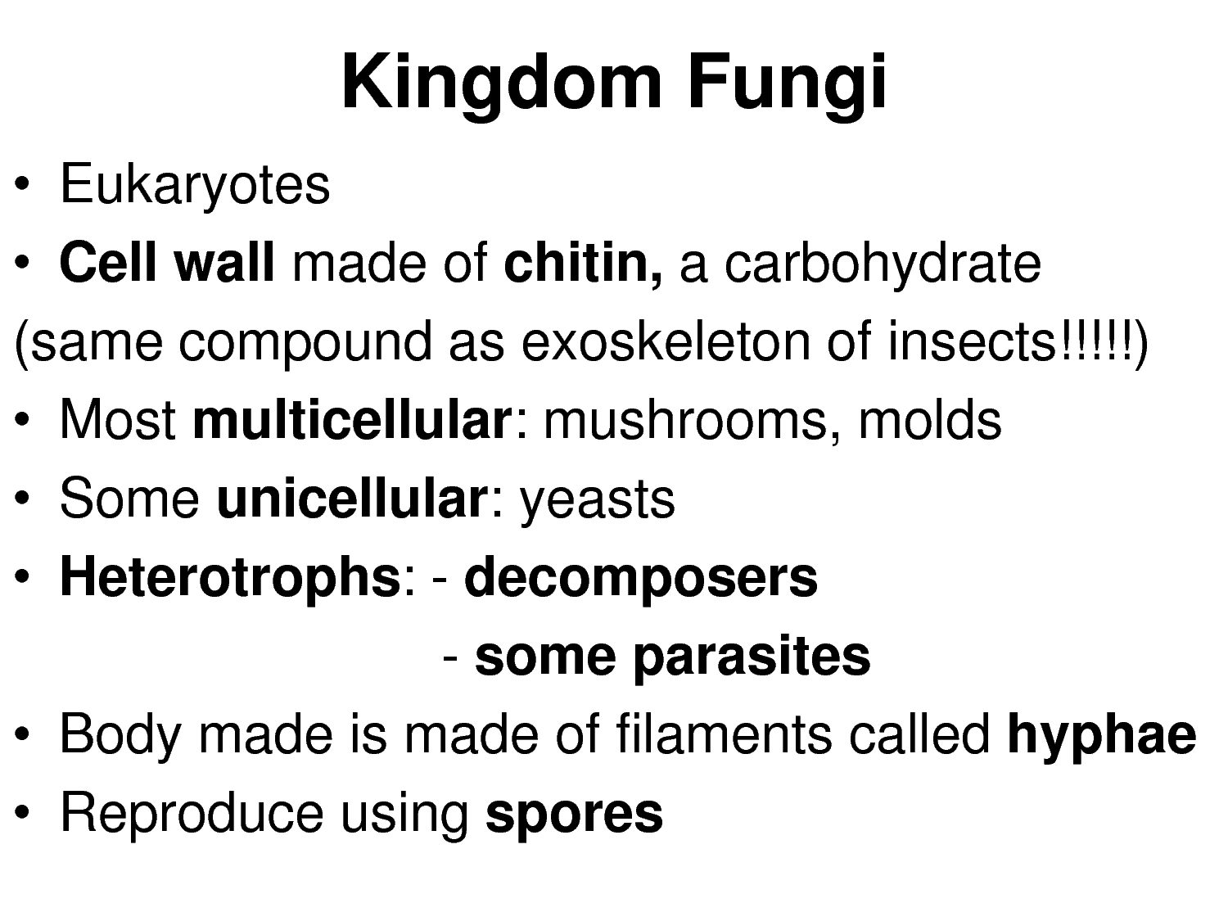

Slide 16
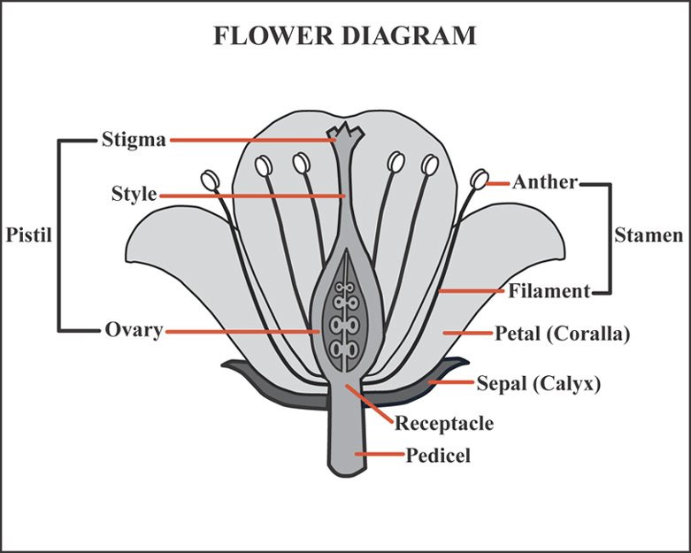

Slide 17
Questions
What is the chemical equation for photosynthesis?
True or False: Fungi are Autotrophs.
What are 2 other characteristics of Fungi?
Name all the female parts of the flower.
16. What is the function of the sepal?

Slide 18
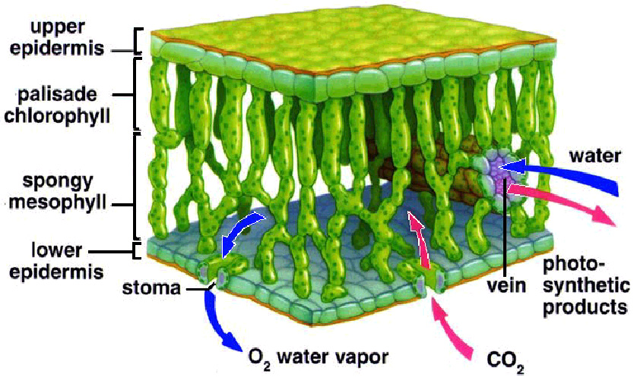

Slide 19
What is the function of the stomata?
The ________ cells open and close to regulate the stomata.
19. Which layer of the leaf does photosynthesis take place in?
A. Epidermis B. Mesophyll C. Palisade D. Cortex

Slide 20
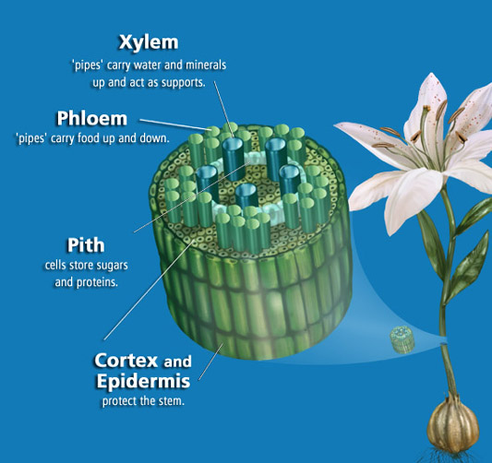

Slide 21
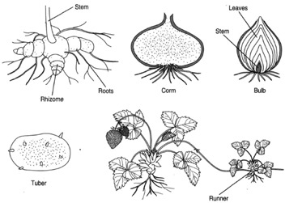

Slide 22
Which vascular tissue is responsible for transporting sugars made in the leaves throughout the plant?
Xylem B. Phloem
21. What are the main functions of the stem?

Slide 23
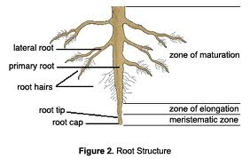

Slide 24
22. What are the main functions of roots?
23. What are the functions of the root hairs.

Slide 25
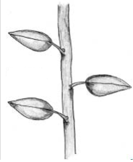
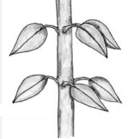
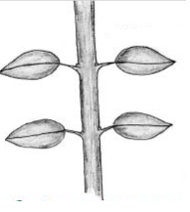
Plant leaf arrangement

Slide 27
Questions
24. True or False: A Prokaryote has a nucleus.
25. Give an example of a Prokaryote
26. Give an example of a Eukaryote

